Slide 1
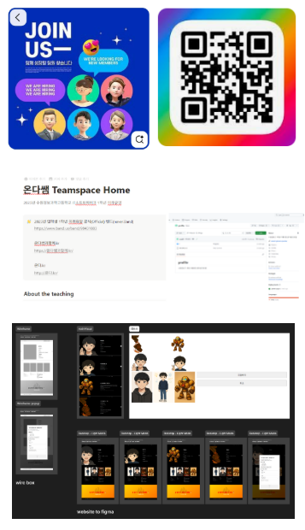



가상팀원모집
HTML Form
Google Sheet
접근성
SEO
Responsive

Slide 2
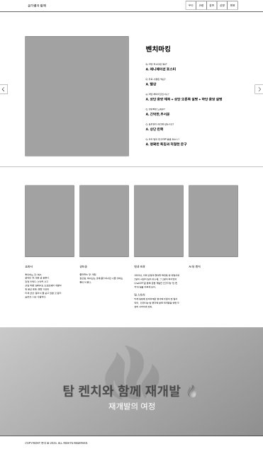
정보구조(IA)
Header
About
Works
Collaboration
Apply
Quality
Footer
BreakPoint

Slide 3
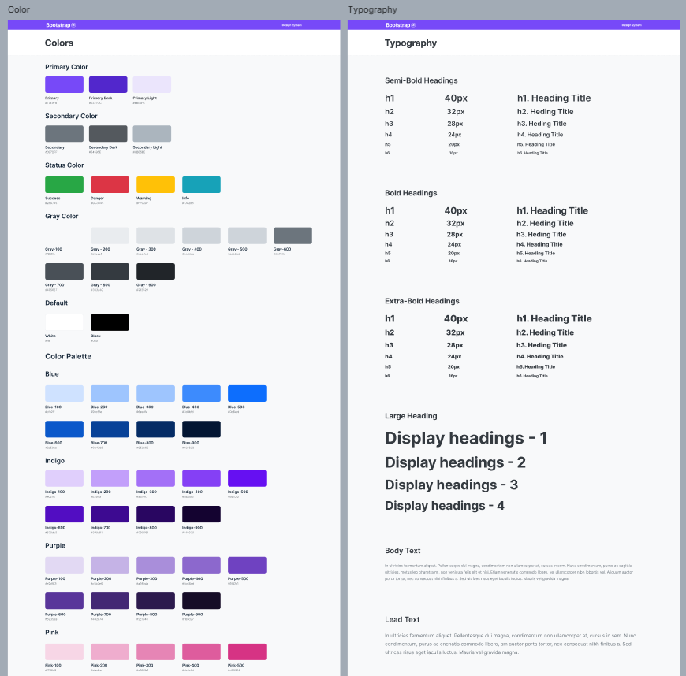
컬러 & 폰트
Primary: #0A3D91
Accent: Gradient
Neutral: #111/#F7F7F8
Font: Noto Sans KR

Slide 4
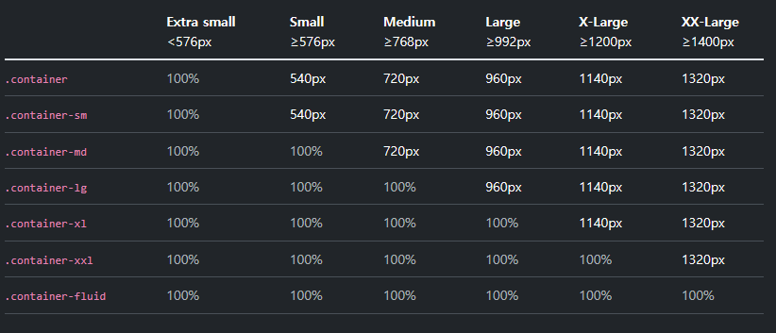
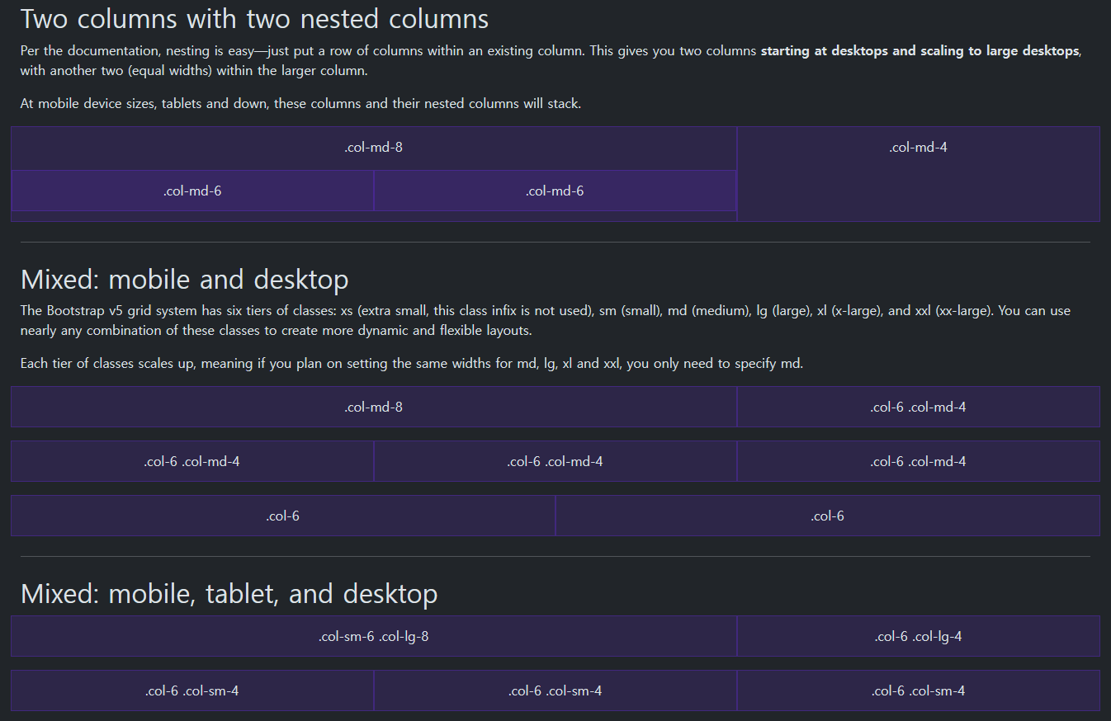
반응형 시나리오

